Slide 1

Cyclistic Bicycles
How Member and Casual Customer Use Differs
8/28/2023

Slide 2
Goals
Explain how bicycle use differs between members and casual customers
Day of Week/Time of Day
Trip Duration
Type of Bicycle
Starting Location
Suggest Recommendations

Slide 3
Data Source
Cyclistic Trip Data
-Made available by Motivate International Inc.
-Data was saved and uploaded to BigQuery for query and addition of calculated columns
-Scope: Only data from files with format DATE-divvy-trip-data.zip were included in this study
-Main table after all loading and cleaning (~16 million records)
Index of bucket "divvy-tripdata"

Slide 4
Data Computation
Add column for duration computed by:
#hours * 60 + #minutes >> round to nearest integer value (stored as integer)
Add column for day of the week for each record

Slide 5
Data Cleaning
Delete from table rows where duration is >= 1 day. Save these records in separate table first to keep this data available.
Delete from table rows where duration is <= 0. Save these records in separate table first to keep this data available.

Slide 6
Data Cleaning: Data where Trip Duration <= 0
-(~360,000) Total Records (removed from main table)
-Locations for these data all appear in country of Georgia, due to positive sign instead of minus sign for starting longitude.
-Implication is that trip duration was computed incorrectly due to diff in timezones.
-Data is added back to main table, sign of longitude data is changed where lon < 0 in data, and duration and weekday are re-calculated.
-Only two records with duration = 0 remain (problem fixed).

Slide 7
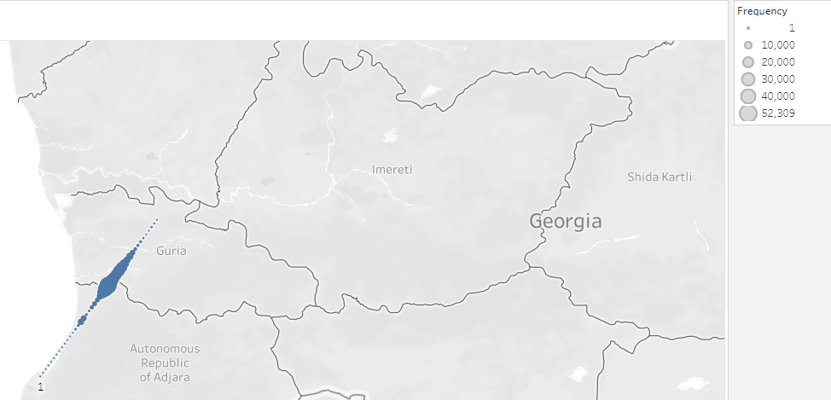

Slide 8
Data Cleaning: Data where Trip Duration >= 1 Day
-Not significant (only ~14,000 records)
-Records have no incorrect lat/lon data as with records where duration was found to be negative.
-These data were not added back in to the main table.

Slide 9
Analysis

Slide 10
Number of Trips by Day of Week
-Overall, highest total frequency (members + non-members separately) on Saturday and Sunday.
-Trips taken M-Th are dominated by members, while trips taken on Saturday and Sunday are dominated by casual customers.
-Approximately equal percentages on Friday

Slide 11
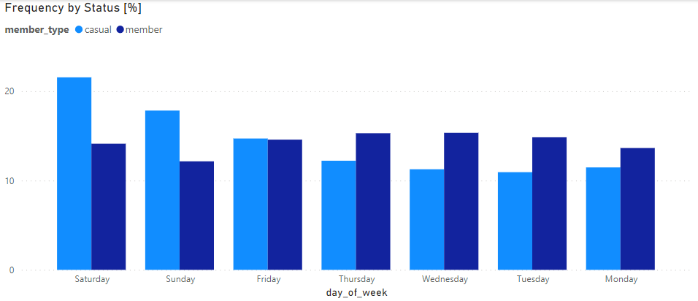

Slide 12
Number of Trips by Time of Day
-Most frequency among both members and non-members occurs around 5 PM.
-Greater proportion of members ride in early morning hours.

Slide 13
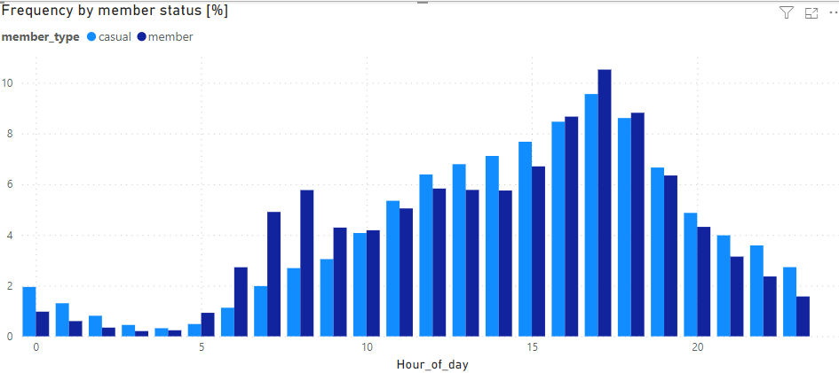

Slide 14
Distribution of Trip Times by Total Time (Normalized)
-Highest proportion in range from ~2 - 20 minutes
-Distribution for non-members shows more frequency of longer trips than for members.
-Short trips are dominated by members.

Slide 15
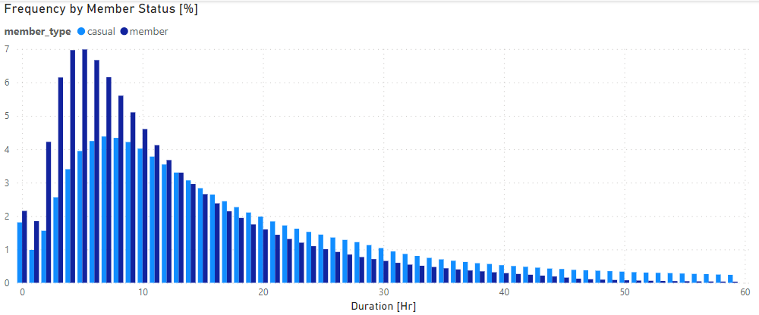

Slide 16
Trips Taken by Bicycle Type
-Most trips taken use the classic bike
-However, proportionately more casual customer trips utilize the electric bike.
-Use of docked bikes (bikes that are retrieved and returned & locked up at stations) is dominated by casual customers.

Slide 17
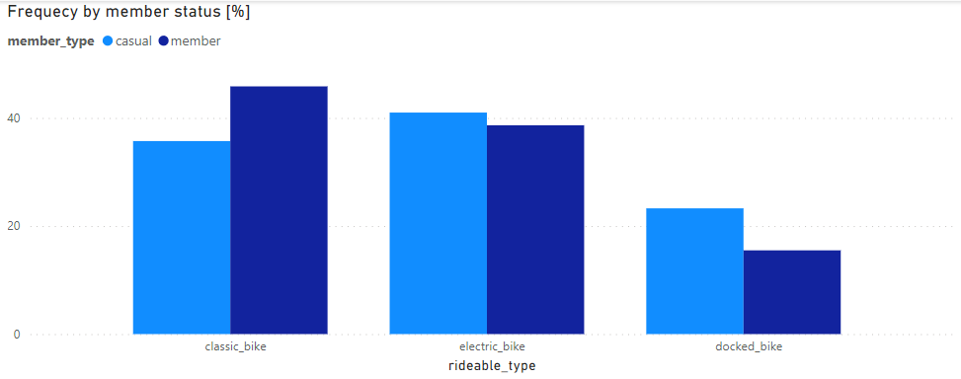

Slide 18
Trends in type of bikes used
-Both members and non-members are increasing their use of electric bikes over time.
-Demand for docked bikes is dying off. Customers might prefer the convenience of being able to retrieve and return bikes at any location in the city (similar to electric scooter brands like Bird and Lime).

Slide 19
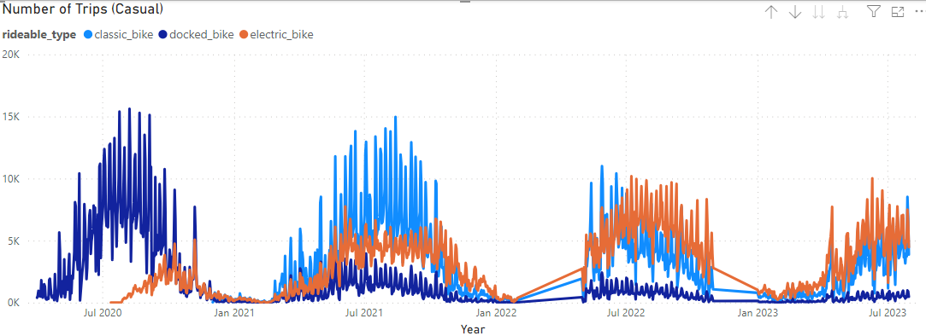

Slide 20
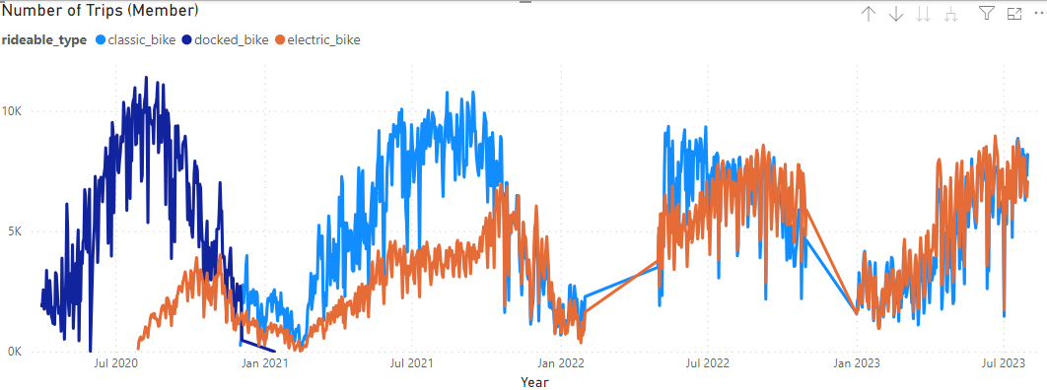

Slide 21
Trips by Duration and Starting Location
-This following plot shows data for trips of count < 100,000 (left) and > 100,000 (right).

Slide 22
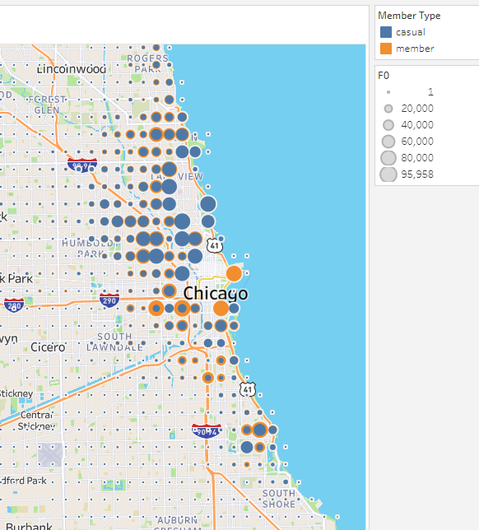
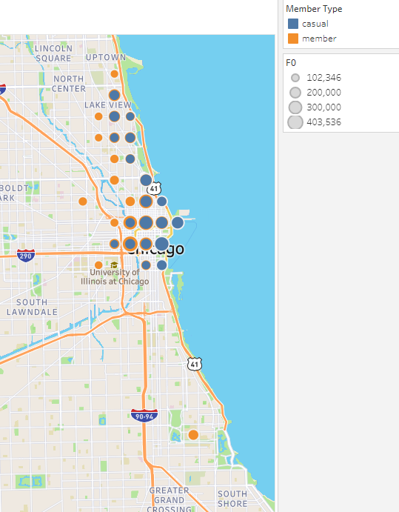

Slide 23
Trips by Duration and Starting Location
-Data suggest that highest concentration of member use appears to be slightly inland of the coast and also closer to the South Shore, while high concentrations of casual customer use appears to be at the coast.

Slide 24
Location by Bike Type
-Most locations are dominated by use of classic and electric bikes.

Slide 25
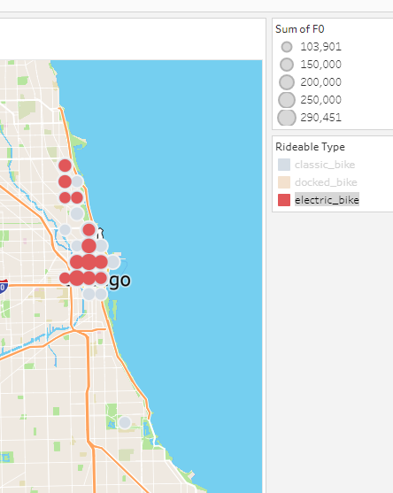
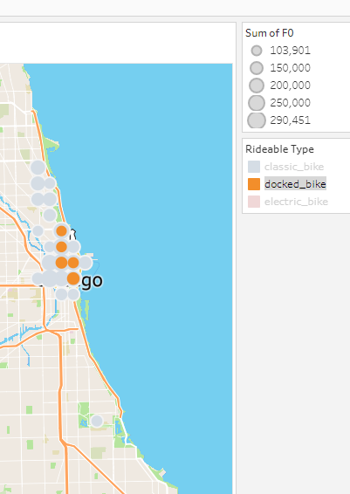

Slide 26
Key Recommendations
-Make more electric bikes available and advertise this to casual customers.
- Advertise to casual customers all available locations they can ride to ensure they are not avoiding membership due to assumption that bikes are unavailable in southern Chicago and further inland.
-Ensure that plenty of bikes are stocked and available in morning hours. Non-members might be deterred by limited availability in morning hours (further investigation is needed).

Slide 27
Questions

